Slide 1

microsoft Linux
a story of linux on azure

Slide 2

{"wtf": "sucker for drama","takeaways": [
{"motivation":"can you do it better"},
{"motivation":"ask Why should you…focus"}]}

Slide 3
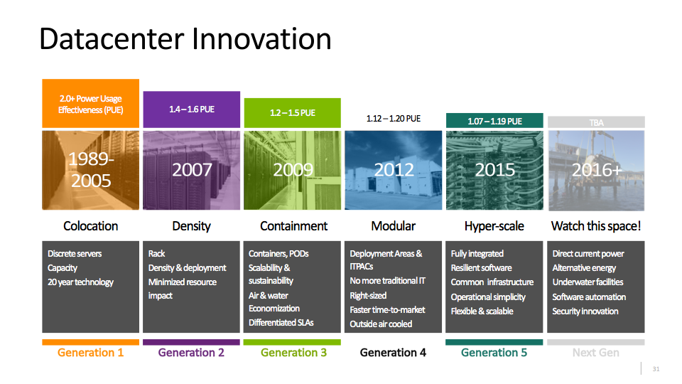

Slide 4
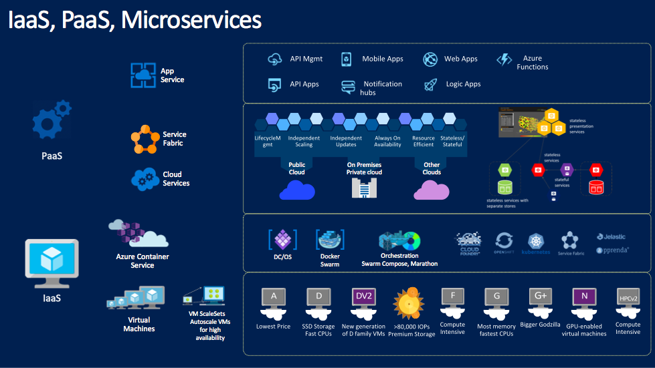
iaaS & Containers

Slide 5



Azure ResourceS
Resource group
Example
Compute: SKU/ CPU/ Mem
Storage account —>Managed disks
VNet + Subnet
Network interface
Network security group
https://resources.azure.com/
http://armviz.io

Slide 6
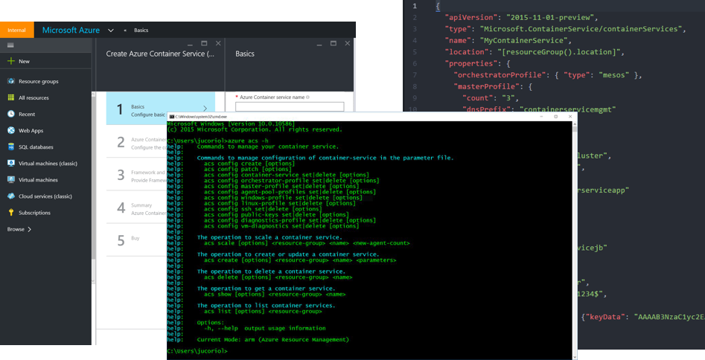
AUTOMATE
PORTAL
CLI/ powershell
ARM
OMS + AUTOMATE

Slide 7
LINUX
supported distros
Linux on hyper-V
Linux integrated Services
cores
credativ
canonical
images created by partners,
tested by Microsoft
oracle
redhat
rogue wave
own/custom images
suse

Slide 8
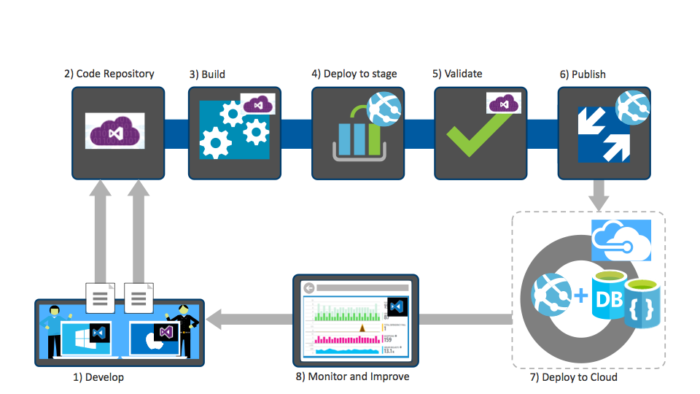
DEMO CICD: packer/ arm and ANsible example

Slide 9
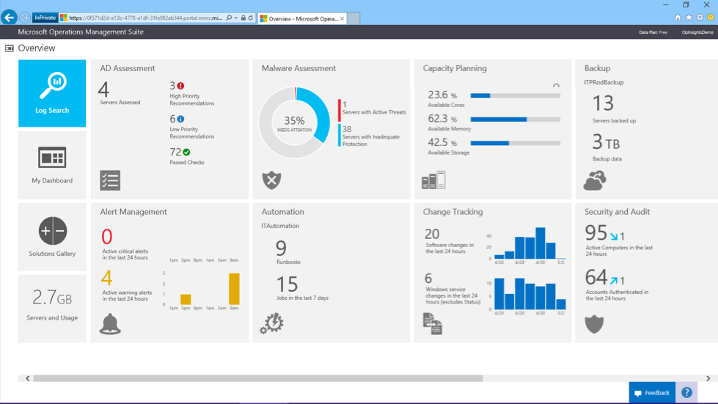
monitoring

Slide 10
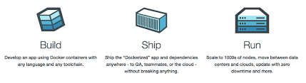
…containers

Slide 11
controlling the madness
OMS + plugins
orchestrators, pipelines, monitoring

Slide 12
on azure…
Azure container service (engine)
Azure container registry
Azure container instance

Slide 13
DEMO CICD: kubernetes deployment

